Slide 1

LS Global Innovation Challenge
Team Captain ID : 785552
Team Member ids : 174230, 434896, 584961, 578289
Team Name : Team AIMAX
Account name: Merck
Theme Name: S&M: Sales and Market Research
Date: 21/12/2020

Slide 2

Challenges faced by Sales and Marketing teams today
Keeping track of both strategic and tactical elements to build better/optimize brand strategy
Constantly evolving customer engagement models and channels
Having to demonstrate high return on investment (ROI) from a diverse portfolio of marketing programs
Inability to accurately determine the channel (sub)-wise impact of promotion on brand sales
The absence of a unified data-driven Marketing Analytics tool to act as a hub for Marketing planning and optimization processes
Deciding Marketing Mix based on hunch/experience and industry practices instead of a analysis-based method
Connecting with customers through the right engagement channels
Standardizing KPIs across multiple engagement channels to get a holistic view of promotions – both traditional and digital media marketing

Slide 3

Theme name: S&M: Sales and Market Research
AIMAX- Marketing Optimizer
Our AIMAX Tool helps Brand and Marketing teams to take informed strategic and tactical marketing decisions by providing actionable insights to develop effective promotional strategies.
With use of AI/ML, the application has built-in cognitive capability to determine the principal components influencing relation between promotion type and growth, define appropriate customer segments using both potential and behavior features, perform dynamic market sizing with prospective view considering future events and eventually provide recommendations for optimal marketing mix to maximize effectiveness and generate the highest return on promotional investment.

Slide 4

AIMAX- Intro
A comprehensive AI/ML enabled Marketing Analytics tool to function as a one-stop solution for Marketing planning and optimization processes- to help plan marketing activities and investments across multiple channels, enabling data-driven decision-making for best results
Follows a holistic approach that takes into account all available and meaningful information and turns customer interactions & activities across channels into actionable insights
AIMAX will help answer key questions that marketers face while devising Brand Strategies
How to identify right engagement channels and optimal mix for better results
What is the channel-wise impact of promotions on brand sales and growth
How can I improve ROI by Optimizing marketing budget allocation across marketing channels
Success Factors
Standardized Promotional Plan
Relevant Analytics
Uniform view of markets
Real Time Insights
How to target specific competitors by strategizing channel wise spend
What would be the future market scenario and growth trajectory of a brand
Continuously Learning Model
Go to Market Strategy

Slide 5








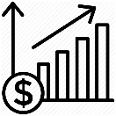

Solution Features & Capability
Advanced marketing analytics solution that leverages a thorough data strategy coupled with advanced analytics methodologies to derive insights for marketing
Customer Data Center
Advanced Analytics & Insights
Personalization
Strategic Approach
Omni-channel data integration for holistic customer and business performance view
Sophisticated analytics to deepen customer and business insights for better ROI
Redefine the way to engage and drive top-line revenues through personalization
360°view of market and brand to enable proper planning and execution
Advanced Analytics Reusable Assets
Channel Impact
Channel Mix Identification
Promotional Spend Optimization
Brand Performance Analysis
Market Forecasting
Measure the impact of each marketing channels and identify right engagement channels for marketing strategy
Identify the optimal Multi - Channel Mix for promotion activities
Evaluate channels for promotion response and optimize the spend across the channels
Competitor analysis to show the performance of a brand in a particular therapy area
Leverage past promotion data and predict how proposed promotions may affect the future

Slide 6

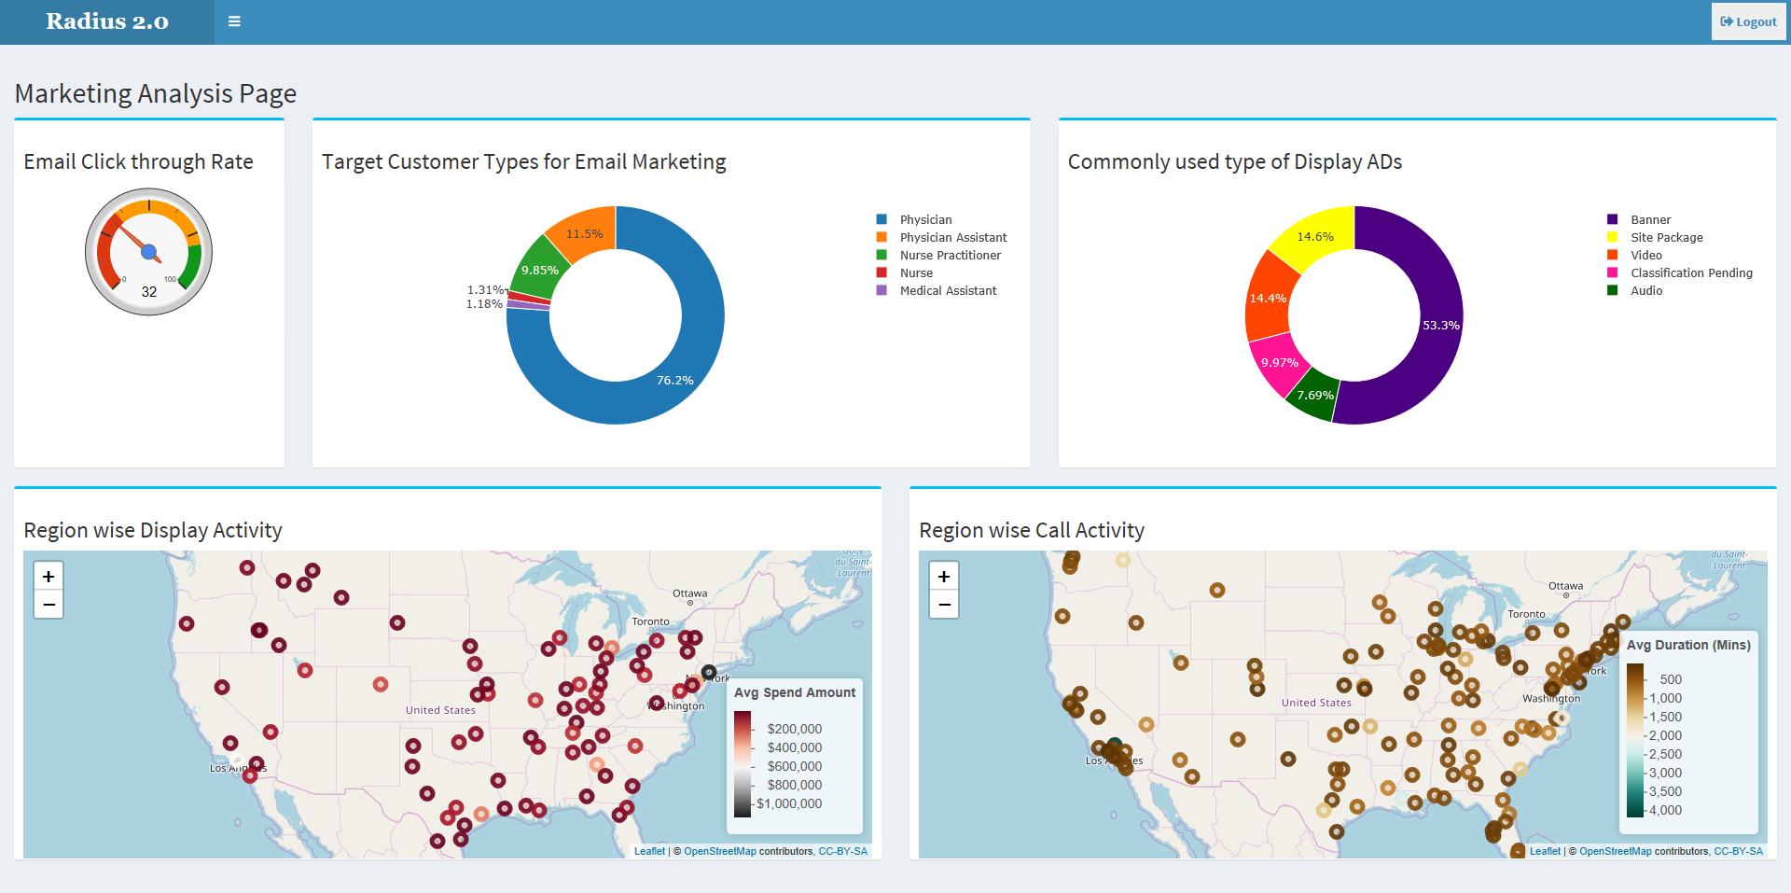
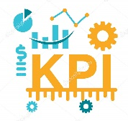





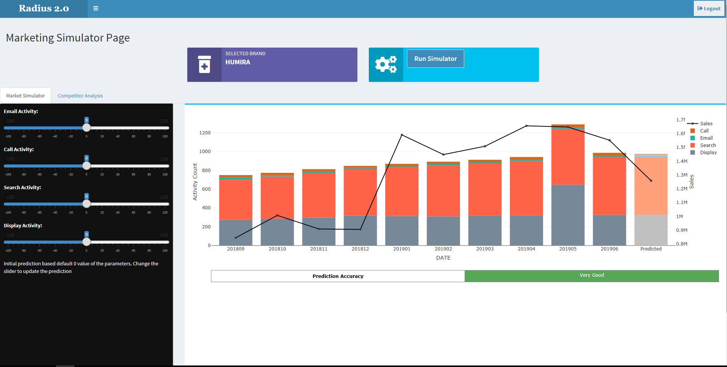


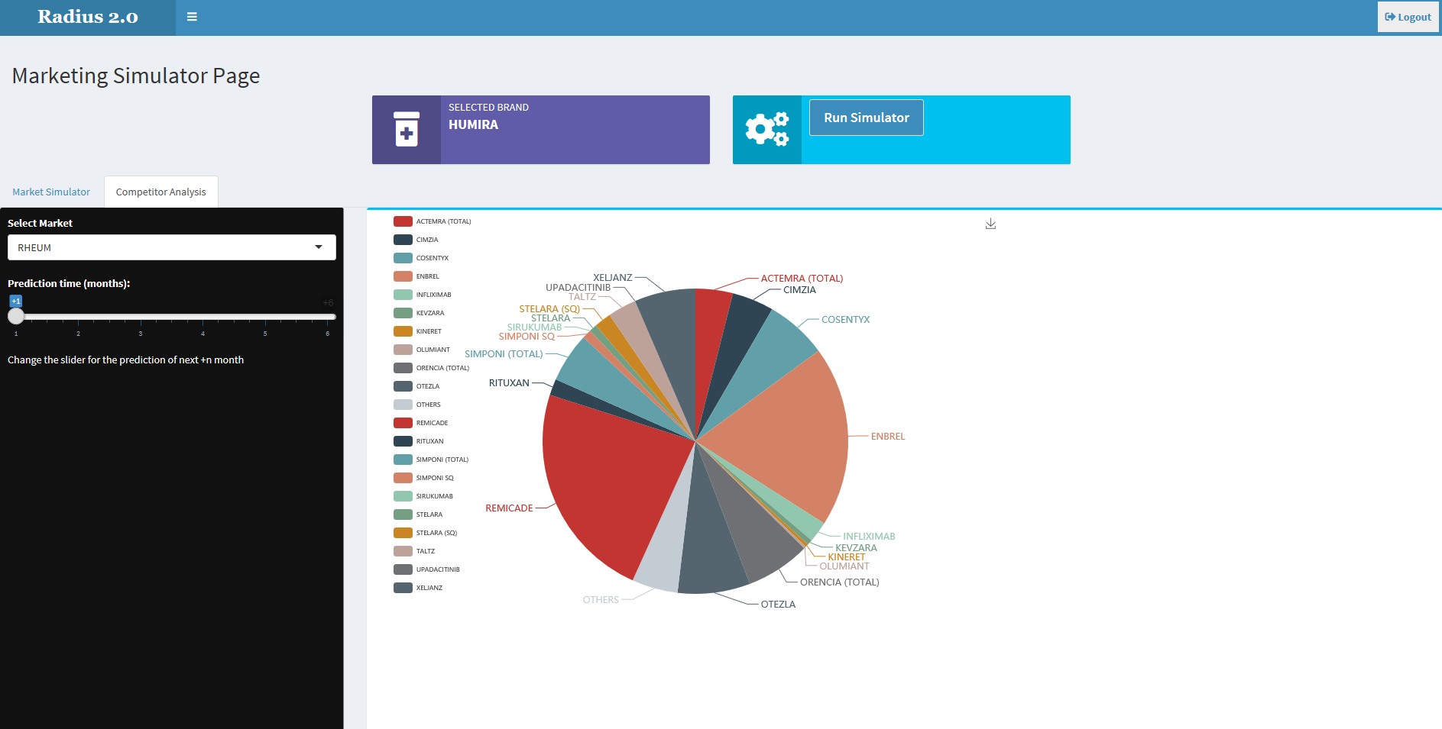
High level Solution Architecture
Data Layer
Business Logic
Model & Analysis
Data Components
Data Preprocessing
KPI
Algorithm Development
Marketing Mix Recommendation
Digital Channels
Recommendation Engine
Data Ingestion
Data Cleaning & Validation
Identifying Right Channel Mix
Promotional Spend Optimization
Brand Performance Analysis
Market Forecasting
Advanced Analytics
Designing ML methodology
Descriptive and Predictive Analysis
Forecasting
AI recommendation Engine
ROI
Campaign
Activity
Response
Etc..
ROI: for individual/mix of channels
Traditional Data Warehouse
Market Simulator
Marketing Channels
Sales data
Promotional Spending
Market Rx
Etc..
Channel Effectiveness & Forecast
Brand Performance
Brand & Market Analysis and Forecast

Slide 7




AI/ML Intervention
AIMAX AI/ML Core Engine
AIMAX Value Creators
Multi-channel Marketing Data
Activity Count/type
Investment
ML Metadata
Continuous learning model for accurate real-time analysis
Sales-Marketing Mix Regression model
AI-based Channel Impact Simulator
Predicted impact of each channel on brand sales
Sales Data
Ridge, Lasso, Elastic Net
ROI Calculator
Promotion Response and Channel Deep-dive
User Budget Input
AI-based Marketing Mix Recommendation Engine
Optimal multi-channel Marketing Mix recommendation
Prediction of future market scenario, considering market conditions like promotions & competitor performance
Market Rx Data
AI-based Market Simulator
Time Series Forecasting

Slide 8



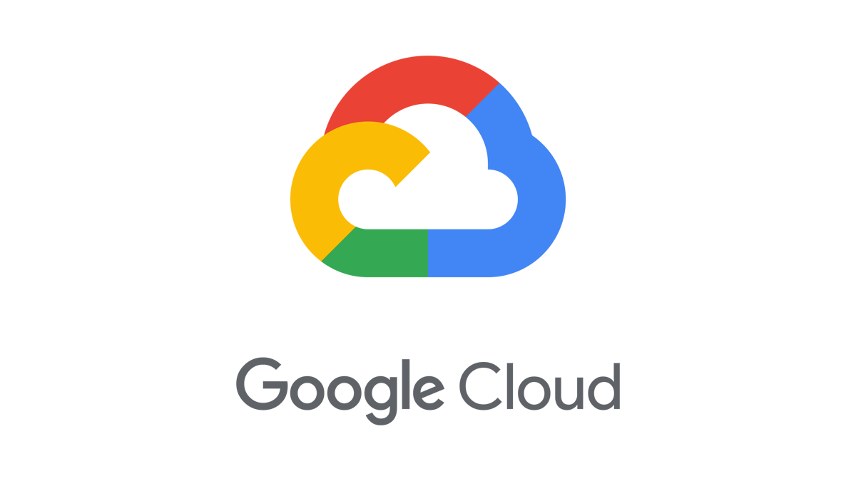


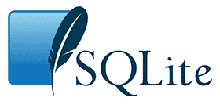
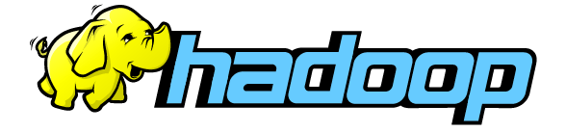

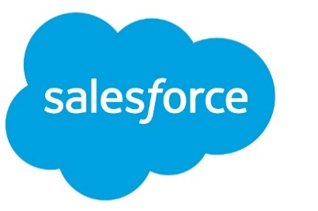

Technology Landscape and Scalability
Integrate within Client Infrastructure/Third party tools
All Open Source Technologies
AIMAX
Zero Investment from Cognizant on Licensing cost

Slide 9
Pricing Model
Illustrative Pricing Structure
Licensing Cost
Particulars | Price $
AIMAX | $ 150,000 – 250,000
SME (onsite) | $ 125 per hour
SME (offshore) | $ 45 per hour
Implementation Approaches:
MODEL 1: SaaS Annual Licensing Cost + Set up cost ( 1 Developer for 1M) + Configuration Support (1 DS for 1M)
MODEL 2: Project/Contract Annual Licensing Cost + Set up cost ( 1 Developer for 1M) + Annual SME Support (Onsite/Offshore model based on Customer requirement). Configuration Cost to waived off
1
The intent is to get an IP for solution and will be deployed at Client’s environment based on annual licensing cost
Deployment Cost
2
Solution to have flexibility to opt for individual modules
For limited modules, there will be deployment cost
Cost to be waived of on selection of most / all modules
SME Consulting
Assumptions
Application to be hosted in Client’s environment. Incase Client needs support of Cognizant infrastructure, the cost logistics will be estimated separately
Consulting support will be on fixed capacity basis (based on work volume , market mix model refresh cycles , and customer adhoc requirements)
Any customization in application post deployment to be done through separate CR
3
Optional SME consulting support at following stages :
While defining KPIs and channel optimization
During deployment of the solution across each market

Slide 10
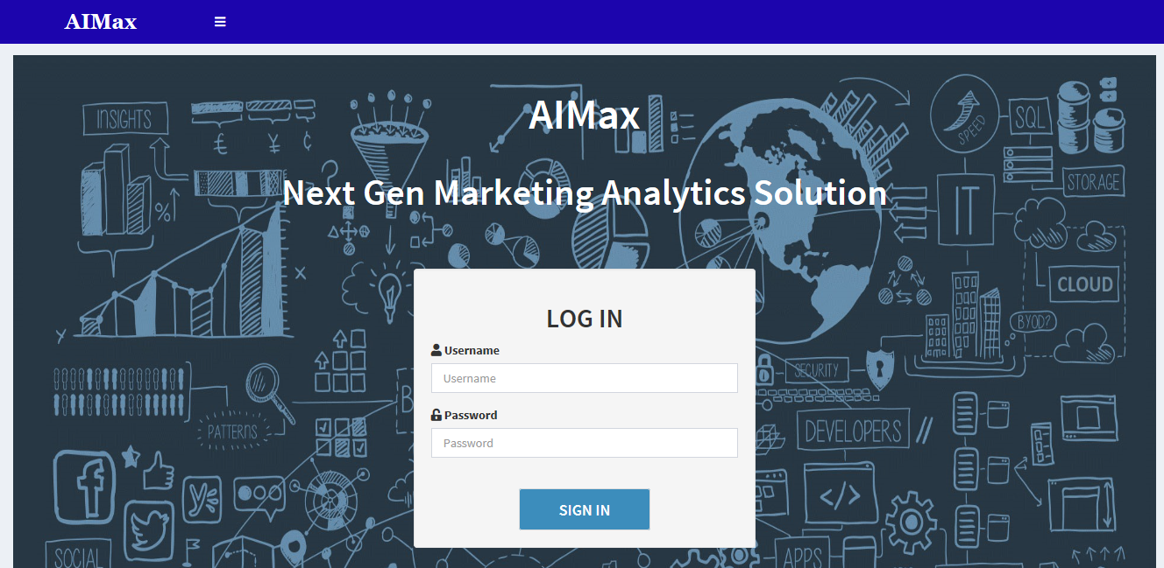
Prototype

Slide 11
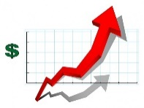







Benefits
Why should Cognizant invest in this solution?
Why should clients invest in this solution?
Tremendous market potential
V.Low Investment - High Return
Existing tools only cover traditional problems where AIMAX will be Cognizant’s edge in hybrid marketing analytics solutions using AI/ML
Use of open source technology (R, Rshiny), thus no licensing cost involved in application build
End-to-end analytics solution for Marketing planning and Investment optimization
Holistic view of multi-channel marketing KPIs
Predictive (Market Potential) and Prescriptive (Recommendations) insights for appropriate channel selection and budget allocation
Sophisticated analytics with focusing on both traditional and digital marketing for higher ROI
Modular approach with flexibility to deploy specific analysis based on customer requirement
Easy customization- scalable solution for changing market dynamics

Slide 12
Challenges & Mitigation
Custom Approach vs Standardized Process
Traditionally each local brand teams used to derive portfolio investment locally
AIMAX to have easy customization for local market needs with essence of global KPIs for better performance tracking
Stiff Competition: Considering the practice of investment optimization are there for ages in S&M domain, we anticipate lot of options for clients
AIMAX will provide recommendation based on both hindsight and foresight which will be its USP
Insufficient and Siloed data: One of the major challenge is limited data availability by channel and also in disparate datasets for meaningful analysis
Although data processing and standardization is not part of AIMAX standard suite, but we can provide additional ad hoc analytical support like UOM, Gap Assessment for Client
AIMAX has been built based on our years of experience in this field focusing on KPI that matter most. However the solution is nimble with scope for evolving as per Client need
Striking the right balance between experience and data based insight.

Slide 13





Closing Notes: Key Highlights of the solution
  Recommendation Engine
For optimal marketing mix recommendations for greater ROI
Channel Deep Dive
For more intel on key KPIs to identify and compare channel effects on sales
Focussed AI/ML Approach
For perfect mix of human (domain) intelligence with data driven insights…
Market Simulator
To better plan future strategic Marketing activities
Customizable Solution
Modular approach with ability to integrate with existing tools/platforms

Slide 14
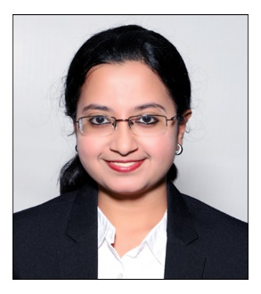
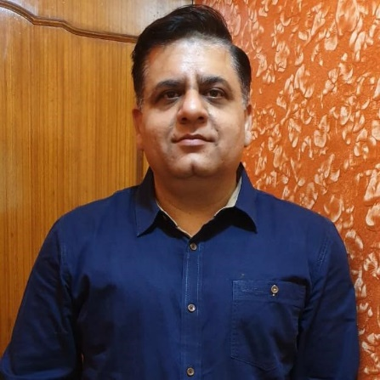



Thank You
AIMAX Team
Akshara Venkatesan
Sudhir Kapoor
Raju Chowdhury
Siddharth Rajendra Jain
Vishwadeep Shukla
14
© 2018 Cognizant

Slide 15
APPENDIX

Slide 16



Optimal Promotional Channel Marketing Mix with
AI-based recommendation
Leverage the data from promotional channels along with their return on promotional investment to recommend optimal marketing mix to achieve target sales
  Situation: Pharmaceutical companies allocate the marketing budget in multiple promotional channels varyingly, being unable to identify the optimal Marketing Mix
  Solution: Perform channel (sub) deep-dive and use AI/ML-based recommendation engine to generate the optimal Marketing Mix to promote growth and enhance ROI
Inputs
Approach
Output/Result
Aggregate the product level monthly sales and promotional spend data for all channels
Analyze multiple KPIs to conduct detailed analyses on the nature of multi-channel promotions and investment made on each channel
Build a regression model to determine and measure the impact of channel-wise promotions on total product sales
Perform ROI Analysis on each promotional channel to identify the best performing channels
Build a model to give optimal Marketing Mix to achieve the target Sales with highest ROI
  Multi-channel promotional data for identified products and it’s related market basket
  Sales data of brand
Summary of promotional spending on different channels along with determining the effect of marketing programs/campaigns
Recommendation on optimal Marketing Mix that can generate target brand sales which can simulate changing scenarios
Improve ROI by Optimizing marketing budget allocation and spends across marketing channels
Efficient method to plan marketing investments across multiple channels for greater ROI

Slide 17
Channel-Impact Simulator
Leverage the data from promotional channels to determine the channel-wise effectiveness and impact on Sales
  Situation: Pharmaceutical companies allocate the marketing budget in multiple promotional channels where the returns/impact are difficult to measure
  Solution: To develop the best multi-channel promotional strategies by identifying the most responsive channels using AI/ML-based simulator
Inputs
Approach
Output/Result
Aggregate the product level monthly sales and promotional spend data for all channels
Build a regression model to determine and measure the impact of channel-wise promotions on total product sales
Develop an interactive Simulator to show the impact of each channel on brand Sales
Increasing/Decreasing promotional channel activity will lead to the prediction of future sales using appropriate regression model with a marginal utility effect baked in
  Multi-channel promotional data for different products and markets
  Sales data of brand
Helpful for pharma clients to analyze conversions from multiple channels and understand how they are evolving and spreading
Understand the promotional spending based on different promotional channels and its effect in overall sales of product
Simulate the impact of varying Marketing Mix on Brand Sales

Slide 18

Brand Performance Analysis with Market Simulator for forecasting future performance
Leverage past promotion and sales data and simulate the future outcomes
  Situation: Brand teams would like have an outlook about the marketing investment for future to plan for long term need.
  Solution: Build a forecast model to generate drug sales simulating the future market situation including appropriate market conditions like promotions & competitor performance
Inputs
Approach
Output/Result
Aggregate brand level monthly sales and promotional spend data for all channels
Determine competitive performance of a brand in its franchise
Forecast the product sales on the basis of historical data where promotional channel spending is taken as input variable and Market Rx is taken as output variable
The historical data from Market Rx of competitor as well as own product is used for time series analysis
Aggregation of all the product sales from individual market will lead to determination of overall market scenario in the future
  Monthly Brand Rx
  Monthly spend on each promotional channel
  Market Performance data
  Competitor Analysis data
This type of time series analysis may aid in
  Determining how past promotions affected the historical sales
  Predicting how proposed promotions may influence the future
Recommendation of marketing strategies on the basis of appropriate chosen promotional mix
Forecasting the future market scenario on the basis of existing marketing strategy

